Slide 1
Chapter 8
Creating Tables
and Forms

Slide 2
Chapter Objectives
You will have mastered the material in this chapter when you can:
Define table elements
Describe the steps used to plan, design, and code a table
Create a table with rows and data
Insert a table caption
Style a table for tablet and desktop viewports
Describe form controls and their uses

Slide 3
Chapter Objectives (continued)
Use the form and input elements
Create text input controls, labels, and check boxes
Create a selection menu with multiple options
Use the textarea element
Create a Submit button

Slide 4
Introduction
Tables present related information in rows and columns
Useful when comparing types of data or listing topics and details
Helpful when you need to provide a lot of content in a compact form
Many businesses use forms to collect information about their customers
Common information includes a customer’s first and last names, address, email address, and phone number

Slide 5
Project—Create a Table and a Form
Roadmap
Create the Classes page and its table
Style the table for tablet and desktop viewports
Create a form on the Contact Us page
Style the form for mobile, tablet, and desktop viewports

Slide 6
Discovering Tables
Tables compare data or outline a detailed topic, such as a schedule or menu, in a compact format
Row: horizontal line of information
Column: vertical line of information
Cell: intersection of a row and a column and usually contains data
Header cell displays text as bold and center-aligned
Data cell displays normal, left-aligned text and contains information appropriate for the column and row

Slide 7
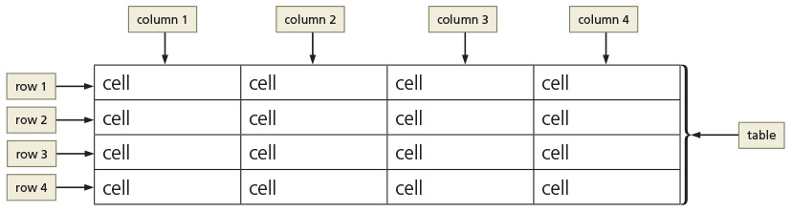
Discovering Tables (continued)
Figure 8–4

Slide 8
Creating a Table with HTML Elements
Element | Indicates the start and end of: | Contains:
<table> … </table> | Table within a webpage | All related table elements
<tr> … </tr> | Table row within a table | Table data cells
<th> … </th> | Table header cell | Table header content
<td> … </td> | Table data | Table cell content
<caption> … </caption> | Table caption | Table caption or title
<thead> … </thead > | Table header area | Grouped header content
<tbody> … </tbody > | Table body area | Grouped body content
<tfooter> … </tfooter > | Table footer area | Grouped footer content
Table 8–1 HTML Table Elements

Slide 9
Creating a Table with HTML Elements (continued)
Creating a table on a webpage
The <table> and </table> tags indicate the starting and ending of a table
The <tr> and </tr> tags indicate the starting and ending of each table row
The <td> and </td> tags indicate the starting and ending tags for data elements within the table row elements

Slide 10
Table Borders, Headers, and Captions
Table border
Line that defines the perimeter of the table
Table header
Heading cell
Identifies the row or column content
Defined with a starting <th> tag and an ending </th> tag

Slide 11
Table Borders, Headers, and Captions (continued 1)
Table caption
Descriptive text that serves as a title or identifies the table’s purpose
Defined with a starting <caption> tag and an ending </caption> tag
Inserted after the starting <table> tag
A table can have only one caption
Tables can include headers and captions individually or in combination

Slide 12
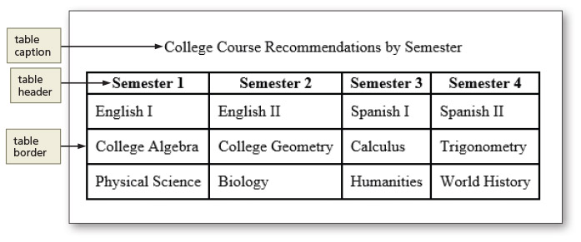
Table Borders, Headers, and Captions (continued 2)
Figure 8–6

Slide 13
Table Element Attributes
Three primary attributes cam be used within a table
The id attribute is used to specify a unique id for a table when necessary
The colspan attribute is used to span text or other content across two or more columns
The rowspan attribute is used to span across two or more rows

Slide 14
Use of Tables
Before you add a table, first determine whether it is necessary on the webpage
As general rule, use a table when it will help organize information so that that it is easier for the user to read
Tables are also useful if the webpage needs to display a structured, organized list of information

Slide 15
Use of Tables (continued)
Tables
Display data in rows and columns
Should not be used to design a layout for a webpage
Help organize information so that it is easier for the user to read
Useful if the webpage needs to display a structured, organized list of information

Slide 16
Planning the Table
To create effective tables plan the information that will appear in columns and rows
Create a design that presents the information clearly
Planning a table for responsive web design
Give careful consideration to the mobile viewport because of its screen size

Slide 17
Styling Table Elements
After creating a table, style it by adding new style rules to the style sheet for the website
You can specify style rules for each table element
Table 8–2 lists common CSS properties and examples for styling tables

Slide 18
Styling Table Elements (continued)
Separated border
When a border is applied to table elements, by default, each cell has its own border, making the table appear to use double lines between each table data cell
Collapsed border
Use the border-collapse property with a value of collapse to display a table with single, consolidated borders

Slide 19
Styling Tables for Responsive Web Design
It can be difficult to style a table for a mobile viewport, especially when the table consists of several columns
Determine whether you can format the table so it is still easy to read in a mobile viewport
If the table is too large or complex to format, you can display the content in a different format such as a list or a chart in a mobile viewport

Slide 20
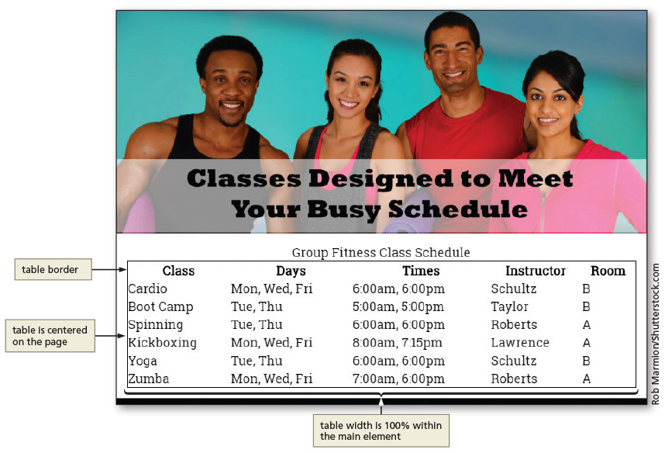
To Style a Table for a Tablet Viewport
Figure 8–25

Slide 21
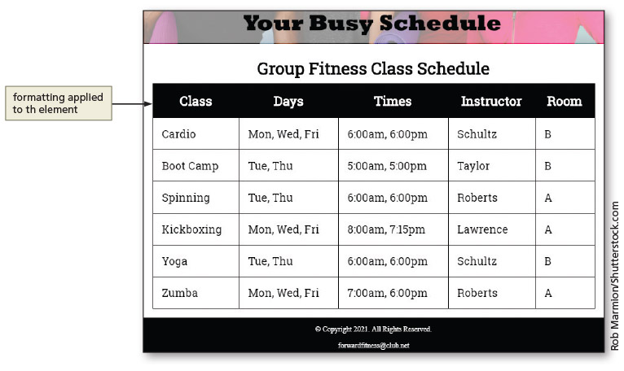
To Style a Table for a Tablet Viewport (continued 1)
Figure 8–31

Slide 22
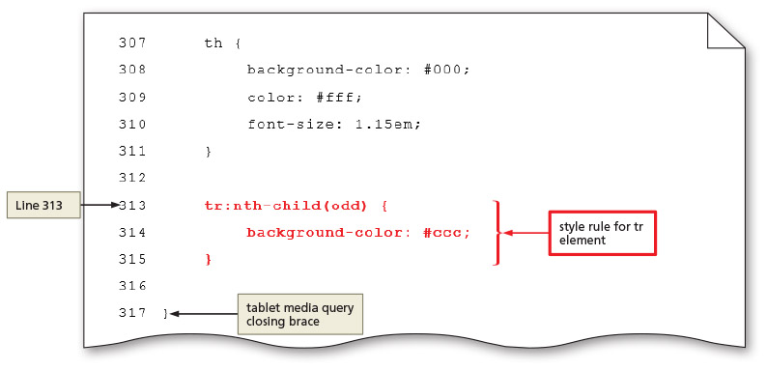
To Style a Table for a Tablet Viewport (continued 2)
Figure 8–32

Slide 23
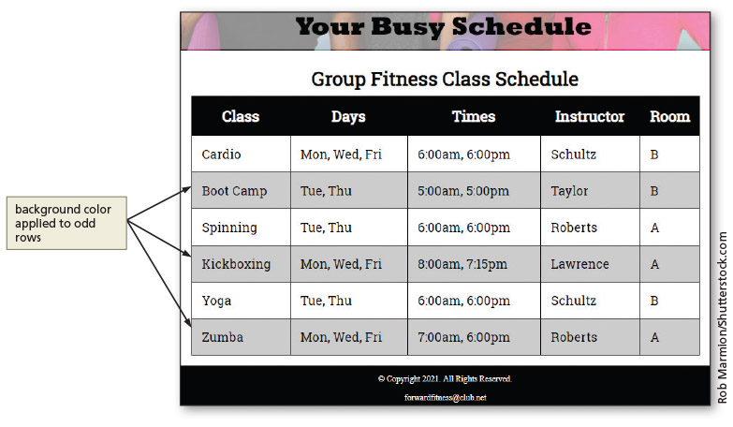
To Style a Table for a Tablet Viewport (continued 3)
Figure 8–33

Slide 24
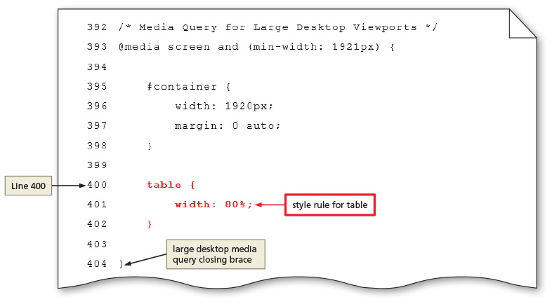
To Style a Table for a Large Desktop Viewport
Figure 8–34

Slide 25
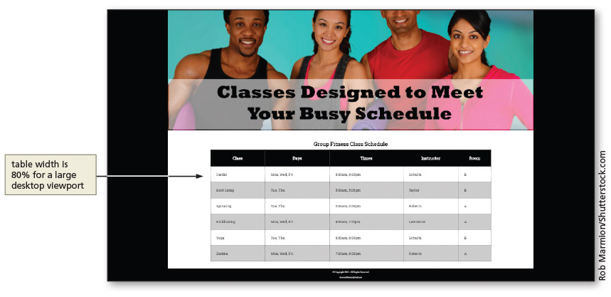
To Style a Table for a Large Desktop Viewport (continued)
Figure 8–35

Slide 26
Creating Webpage Forms
Forms provide a structured way to collect information from webpage visitors
Visitors complete webpage forms to register for an account or to make a purchase
Businesses use forms to gather visitor or customer information and store it in a database for future use

Slide 27
Form Controls
All form elements are contained with the starting <form> tag and the ending </form> tag
Input control: interactive mechanism for users to enter text or make selections on a form
Label: text describing the type of information to enter with an input control
Most controls in an HTML form are defined by using the type attribute of the input element
Define other controls using separate elements, such as the textarea and select elements

Slide 28
Form Controls (continued 1)
Data input control: used to make a selection or perform a command
Can be a radio button (input type="radio"), a check box (input type="checkbox"), a Submit button (input type="submit"), a Reset button (input type="reset"), or a selection menu (select element).
Text input control: accepts text, such as names, dates, and passwords
Often called an input field

Slide 29
Form Controls (continued 2)
Each input control has attributes that are used more frequently than the others
Name: identifies the specific information that is being sent when the form is submitted for processing
All controls have a name
Id: provides a unique ID for the element
Use the id attribute with input controls
Value: specifies the value of an input element
Varies depending on input type

Slide 30
Form Controls (continued 3)
Common input controls used with a form
Text, password, email, checkbox, select, submit, reset, etc.
Text input controls
Text box (text control)
Password text box (password control)
Email text box (email control)
Telephone text box (tel control)
Date text box (date control)
Text area box (textarea control)

Slide 31
Form Controls (continued 4)
These text input controls have two frequently used attributes:
Size: determines width of the control in characters
Maxlength: specifies maximum number of characters accepted

Slide 32
Form Controls (continued 5)
Password control: text control; provides a text box for the password a visitor enters
Email control: text box where visitors enter an email address
Tel control: text box where visitors enter a telephone number
Date control: text box that accepts a date

Slide 33
Form Controls (continued 6)
Textarea control: creates a text box that allows multiple lines of input
To create a textarea control, use the textarea element instead of the input element
Two primary attributes set the size
Rows: specifies the number of rows, or lines, in the textarea control
Cols: sets the width of the textarea control as the number of columns, with each column containing one character

Slide 34
Form Controls (continued 7)
Example of HTML code defining a textarea control:
<label>Please tell us more about your shopping experience with us today.</label>
<textarea name="feedback" rows="5" cols="100"></textarea>

Slide 35
Form Controls (continued 8)
Checkbox control allows a webpage visitor to select items from a list of one or more choices
Each choice appears with a graphical box, which can be checked (selected or on) or unchecked (deselected or off)
By default, all check boxes are deselected
To set a particular check box to be preselected as the default, use the checked attribute and value (checked="checked") within the <input> tag

Slide 36
Form Controls (continued 9)
Radio control limits the webpage visitor to only one choice from a list of choices
Each choice has a radio button, or option button, which appears as an open circle
By default, all radio buttons are deselected
To set a particular button as the default, use the checked attribute and value within the <input> tag

Slide 37
Form Controls (continued 10)
Select control creates a selection menu from which the visitor makes one or more choices
Prevents the visitor from having to type information into a text or textarea control
Suitable when a limited number of choices are available
Appears on a form as a text box with a list arrow

Slide 38
Form Controls (continued 11)
Submit control and reset control create the Submit and Reset buttons
Submit button sends the form information to the appropriate location for processing
When it is clicked on the form, the name of each control and the value of its data are sent to the server to be processed
Reset button clears any input entered in the form, resetting the input controls to their defaults
A webpage form must include a submit control and a reset control
The value attribute specifies the text that appears on the button

Slide 39
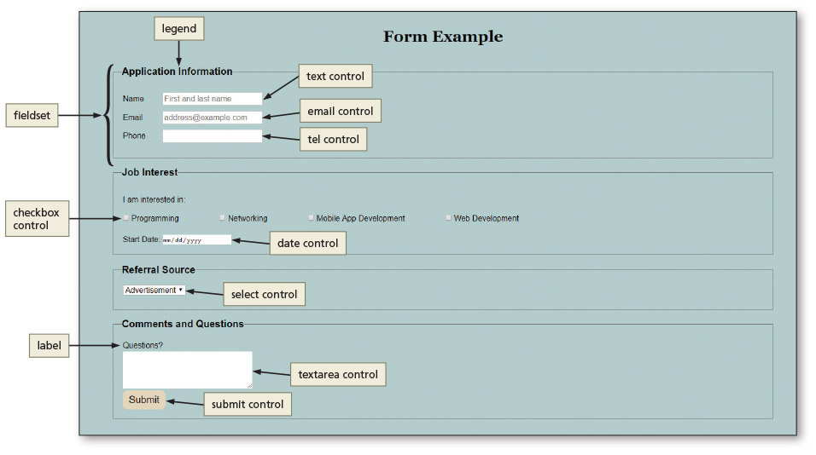
Form Controls (continued 12)
Figure 8–42

Slide 40
Form Labels
Form labels identify the type of information to enter into or select from an input control
Added to a form using the label element
To connect them to their controls, include the for attribute with the same value as the input control’s id value

Slide 41
Attributes of HTML Tags Used to Create Forms
Many of the HTML tags used to create forms have several attributes
Table 8–4 lists common form attributes, including several HTML 5 attributes for the input elements
Many of the attributes are not supported by all major browsers, so be sure to test them first

Slide 42
Form Processing
The action attribute of the <form> tag is used to specify the browser’s action when submitting the form
Browsers can send information entered in forms to a database on a web server or send it by email to an email address
Many websites use form processing software tools available from the web server or website hosting provider

Slide 43
Form Processing (continued)
The method attribute of the <form> tag specifies how to send the data entered in the form to the server to be processed
The get method appends the name-value pairs to the URL indicated in the action attribute
The post method sends a separate data file with the name-value pairs to the URL (or email address) indicated in the action attribute

Slide 44
Styling Forms
CSS styles are applied to forms to improve the appeal and usefulness of the form and its controls
As with tables, consider forms in the context of responsive design
Controls can be included to collect optional information, such as product feedback, in tablet and desktop viewports

Slide 45
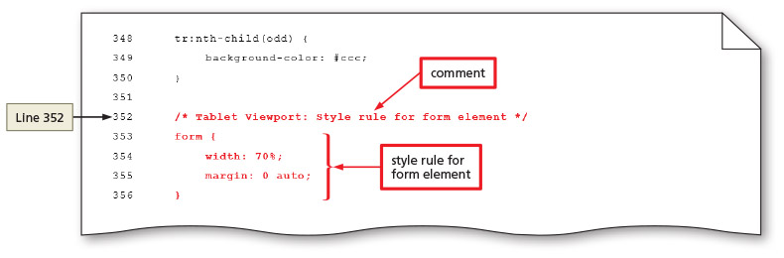
Styling Forms (continued 1)
Figure 8–63

Slide 46
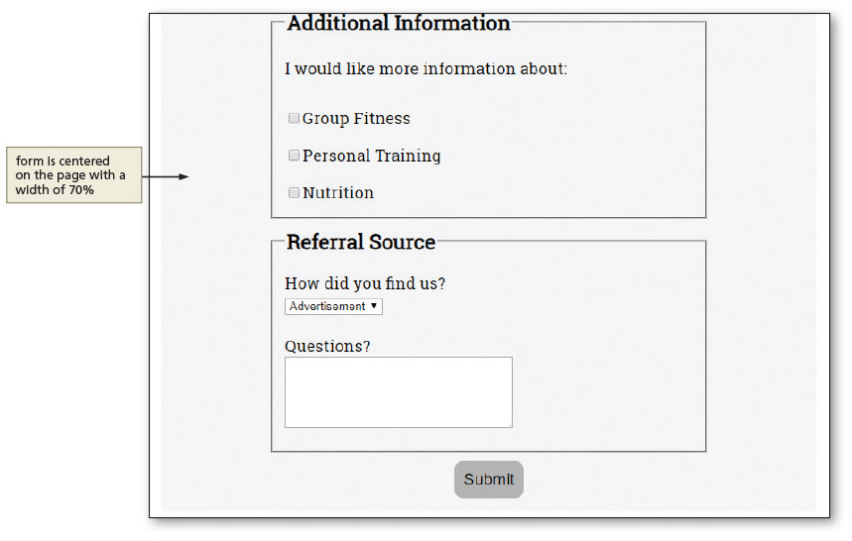
Styling Forms (continued 2)
Figure 8–64
Notes:
Figure 8–64

Slide 47
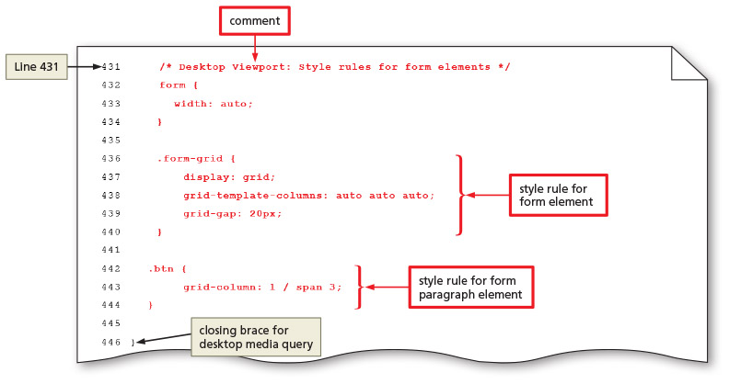
Styling Forms (continued 3)
Figure 8–65

Slide 48
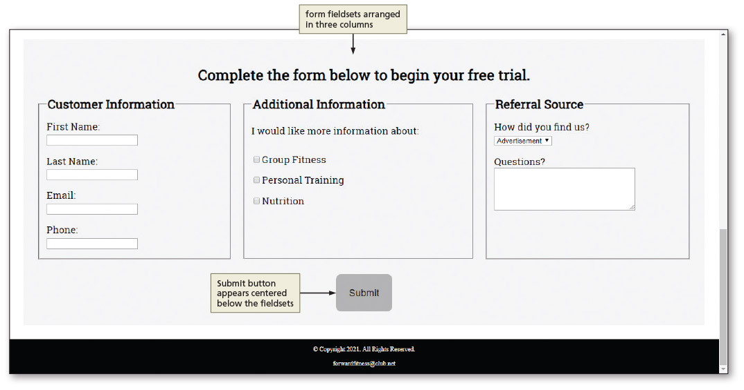
Styling Forms (continued 4)
Figure 8–66

Slide 49
Chapter Summary
In this chapter, you learned how to:
Include tables and forms on webpages
Create a table that displays related information and format it using CSS properties
Use webpage forms and form controls, including the HTML elements, attributes, and values for creating the controls you need
Use CSS styles to format a form for mobile, tablet, and desktop viewports

